Slide 1


INNOVATIVE
INDIA

Slide 2
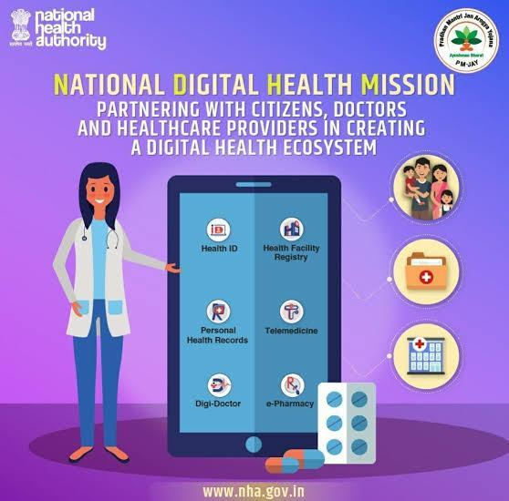
INDEX
TOPIC
INTRO
WHY HEALTH CARD
TEMPLATE
WORKING
SOCIAL RELEVACE
nyj-hnqb-hiw

Slide 3

HEALTH CARD

Slide 4
INTRO
Health card Is a digital card through which one can keep Record of one’s own health . It enables the person to get complete information of his health, details of his medication and all other medical reports in just one click.
Our aim is that each and every citizen of India will have a health card which is having a unique number and a QR code associated with it.
This enables our citizens to continue their medication on any hospital in India with utmost ease and without any delay of time.

Slide 5
WHY HEALTH CARD
The most common thing which we see around is that whenever the patients have to change from one hospital to another , the hospitals will force them to do all the testing and scanning again . This is a heavy burden to them because some tests cost lakhs . In this way many Pvt hospital find profits by fooling innocent people.
The Health card thus works for the welfare of the people by ensuring that all the test details, scanning reports and the medication the patient does is reflected in his/her health card.
The hospital’s themselves can see and verify the records of their patient’s health data . This allows the hospital’s to take quick and effective decision for further medication

Slide 6
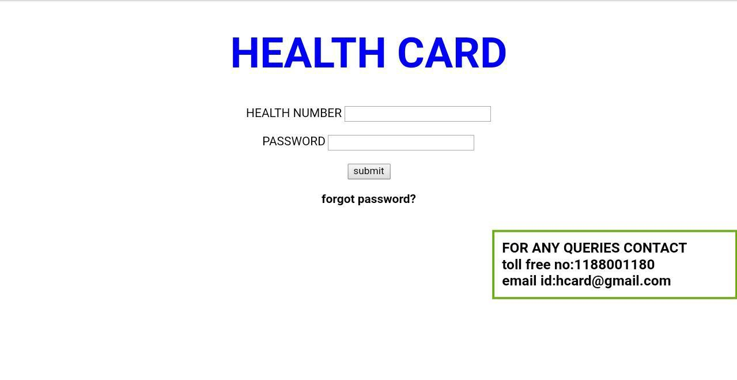
TEMPLATE

Slide 7
WORKING
Every hospital in India will have a specialised QR code scanner which can scan the health cards of people and get their health status. And the hospital authorities will update It with their patient’s recent health status.

Slide 8
SOCIAL RELEVACE
Promotes patient centred health system
Reduce the usage of paper and file work
Improve health condition and consciousness of people
Could get control over the different ways through hospital’s exploit normal citizens of India

